Slide 1

COSTCOMPASS
Navigate the Best Prices, Every time
Project Guide: G. Surekha
21911A0548 – P. Harsh
21911A0525 – G. Bala Satya Sai
21911A0507 – Barmala Venu
21911A0564 – Vanumu Shashidhar

Slide 2
ABSTRACT
CostCompass is a web-based application that simplifies price benchmarking for businesses, procurement teams, and individuals. Using advanced web scraping, it gathers real-time pricing data from various online sources, allowing users to compare costs for a wide range of products and services. By inputting specific models or general specifications, users can quickly retrieve accurate price comparisons, enabling data-driven purchasing decisions.
The app integrates with a robust SQL database for efficient data management and trend analysis, empowering users to track price fluctuations and optimize purchasing strategies. With its simple, user-friendly interface, CostCompass streamlines procurement, reduces decision-making time, and ensures users secure the best deals.

Slide 3
Introduction To CostCompass
What?
Web Application that enables real-time price overview across various platforms.
Purpose
Aims to streamline price benchmarking and help users find the most cost-effective options.
Why?
Quickly go through real time prices and make data-driven purchasing decision, saving time and optimizing costs.

Slide 4
EXISTING TECHNOLOGIES
Existing Platforms
Limitations of existing applications
Broad Coverage
Our Solution
CostCompass offers real-time price comparisons from multiple sources, with trend analysis and a scalable database for accurate and informed decision making.
Individual platforms such as E-Commerce Websites like Amazon, Ebay, etc.
Lack Of Real-Time Data
Ability To Track price trends over time.

Slide 5
LITERATURE SURVEY
Summary
CostCompass is a price benchmarking app designed to assist government procurement by ensuring price reasonability through web scraping and SQL integration. The app’s goal is to promote transparency and fair competition in public procurement by collecting and analyzing prices from multiple sources.
Existing technologies in this domain include
Web scraping tools: Open-source tools like BeautifulSoup and Selenium are widely used for scraping data from websites to aggregate pricing information.
Price comparison engines: Platforms like Google Shopping and PriceGrabber compare prices from various online retailers to help users find the best deal.
Database systems: Relational databases like MySQL and PostgreSQL are commonly used to store and manage large datasets, offering powerful querying and reporting features.

Slide 6
PROPOSED SYSTEM: COSTCOMPASS
Overview
CostCompass is a web-based price benchmarking system that gathers real-time pricing data from various online platforms using web scraping.
It allows users to input product details and instantly retrieve accurate price comparisons, helping them make informed purchasing decisions.
Key Features
Real-time price visualization across multiple sources.
User input for specific product models, brands, or specifications.
SQL database integration for storing and tracking price data over time.
Simple and intuitive user interface for seamless navigation

Slide 7
REQUIREMENTS
Hardware - Server or Cloud platform for hosting the web application - Database Server (SQL) for storing user data - User Devices (PCs, Tablets, Smartphones) for accessing the application
Software - Web scraping tools (e.g., BeautifulSoup, Scrapy) - Backend framework (e.g., Flask) - Frontend Framework (e.g., React) - SQL Database (e.g., MySQL, PostgreSQL) - API for data access and communication

Slide 8
SCOPE
Target Audience - Businesses, procurement teams, and individual users seeking accurate, real-time price comparisons.
Scalability - The system is designed to handle increasing data and user loads with a robust SQL database and efficient web scraping techniques.
Potential for Expansion - Future expansions could include AI-driven price predictions, multi-language support, and integration with e-commerce platforms.
Expected Impact - CostCompass will streamline purchasing processes, reduce decision-making time, and optimize costs for users across various industries.

Slide 9





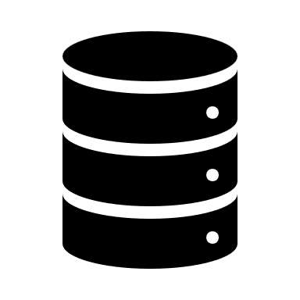

ARCHITECTURE
Front-End
API REQUESTS LAYER
BACKEND
REQUEST HANDLING
WEB SCRAPING
DATABASE

Slide 10
MODULES
User Interface (UI) Module
Web Scraping Module
Backend Processing Module
SQL Database Module

Slide 11
MODULES
1. User Interface (UI) Module
- Purpose: Allows users to input product details (e.g., model, brand, specifications) and view price comparisons and trends.
- Tools: React or similar frontend frameworks.
- Features:
- Input forms for product search.
- Displays real-time price data and trends.
- Responsive design for ease of use on various devices.

Slide 12
MODULES
2. Web Scraping Module
- Purpose: Gathers real-time price data from various online sources.
- Tools: BeautifulSoup, Scrapy.
- Features: - Automates data collection from multiple e-commerce websites.
- Cleans and processes the scraped data to ensure accuracy.
- Periodically updates data to keep information current.

Slide 13
MODULES
3. Backend Processing Module
- Purpose: Handles request processing, coordinates scraping, and manages data retrieval
- Tools: Flask or other backend frameworks.
- Features:
- Receives and processes API requests.
- Manages data scraping schedules and real-time data retrieval.
- Connects with the database for storing and fetching price data.

Slide 14
MODULES
4. SQL Database Module
- Purpose: Stores and manages product pricing data, product information, and historical pricing trends.
- Tools: MySQL, PostgreSQL, or other SQL databases.
- Features:
- Stores product price details and history.
- Tracks price changes for trend analysis.
- Provides quick data access for real-time queries.

Slide 15
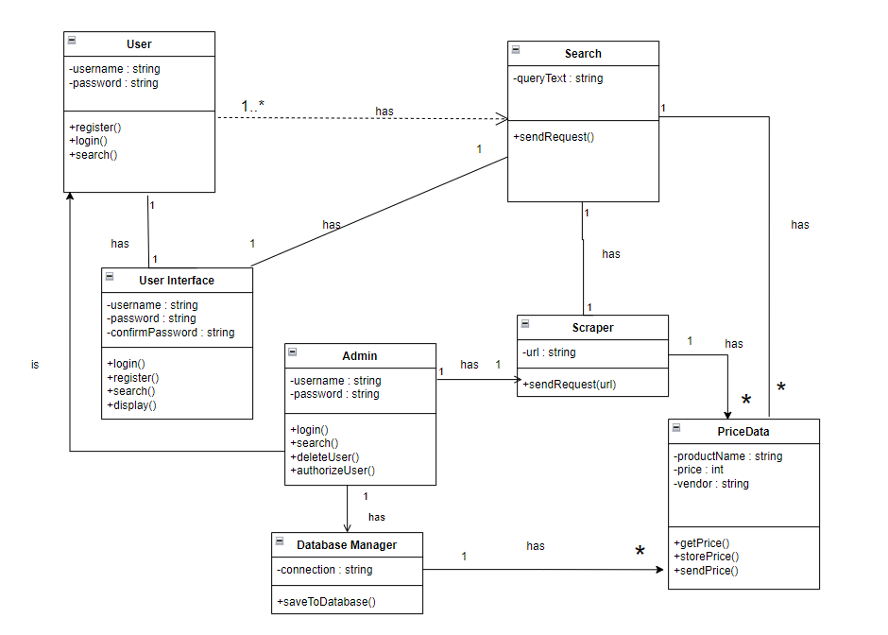
UML DIAGRAMS
CLASS DIAGRAM
Of CostCompass Functionality

Slide 16
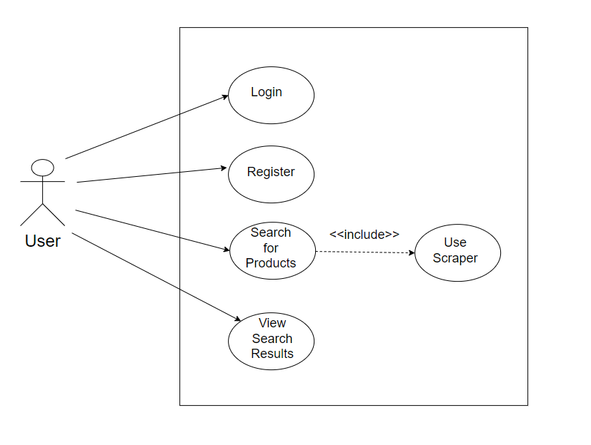
UML DIAGRAMS
System
USE CASE DIAGRAM
For User Interaction with the System

Slide 17
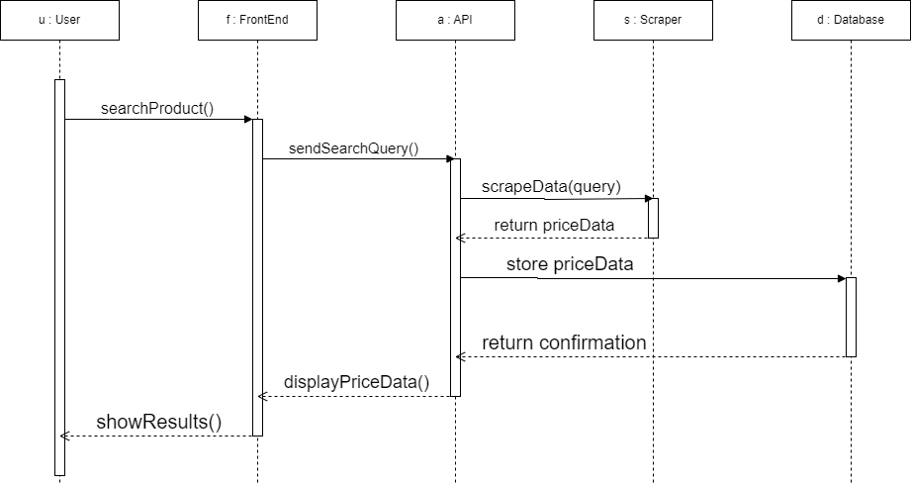
UML DIAGRAMS
SEQUENCE DIAGRAM
Of CostCompass Functionality

Slide 18
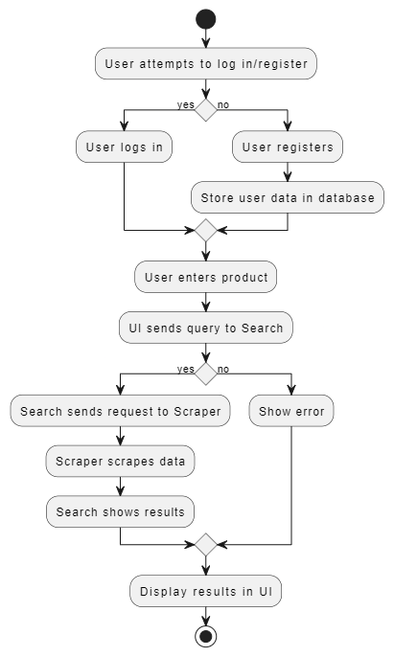
UML DIAGRAMS
User Exists?
ACTIVITY DIAGRAM for CostCompass Functionality
Valid Product?

Slide 19
IMPLEMENTATION
Requirement Gathering & Planning
Frontend Development (React)
Backend Development (Flask)
Web Scraping Module
Database Integration (SQL)
API Integration
User Authentication & Access Control
Testing and Debugging
Deployment

Slide 20
REFERENCES
Fouad, K., & Marwan, D. (2020). A review on web scraping techniques and tools. International Journal of Data Science and Analytics, 7(2), 112-125.
Nambiar, R. (2018). Price comparison engines: Concepts, strategies, and future directions. Journal of Business Analytics, 6(4), 132-145.
Brodsky, A., & Shao, X. (2018). Transparency in public procurement: A case study on the use of price benchmarking tools. Government IT Solutions Journal, 11(3), 41-56.
Zhu, X., & Xu, Z. (2021). Web scraping for price monitoring: Practical approaches and challenges. Journal of Data Engineering, 15(6), 78-92.

Slide 21
THANK YOU!

